Slide 1




Introduction to Computation
Autumn, 2023
Prof. Fan Cheng
Shanghai Jiao Tong University
chengfan85@gmail.com
https://github.com/ichengfan/itc

Slide 2
Outline
Class
Inheritance
Module
Interpreter
9
10

Slide 3


清晰、有条理、减少bug

Slide 4
Class

Slide 5
Module, Class and Function: WHY?
Microsoft’s Win10 has over 50,000,000 lines of codes
Name conflicts in variables and functions
How to cooperate with other programmers
How to maintain such a huge project
We need a mechanism to deal with the complicated problems in real world
How to mange a city with a population of 26,000,000 (e.g., Shanghai)
分而治之：中央政府—省—市
城市分为各个部门：教育、卫生、环保等等 (Module)
部门：提供各种服务 (Class)
In Python
Divide and conquer: module – class – data and function
文件操作、网络模块、数据库、操作系统、科学计算
Collaboration: modules can call each other and reuse their codes
根据问题的需求，将数据和函数封装(encapsulation)成类，把相关的类打包封装成模块
有结构，有组织，有协作，不是一盘散沙

Slide 6
Questions From Past Exercise
When we study trigonometry, we use a, b, c to denote the lengths of three edges of a triangle
In the same Python file, we also use a, b, c to denote coefficients of the quadratic polynomial with one variable
There will be some conflicts between a, b, c in two scenarios
We may also use a, b, c in a tuple unpack: a, b, c = t
It is very messy for a single Python file. Chaos many lead to disaster
We need a mechanism (Python Grammar) to resolve these issues
Encapsulate a, b, c and operations in a triangle
Encapsulate a, b, c and operations in a quadratic polynomial
Keep both (a, b, c) and operations above isolated from a, b, c in the tuple unpack
We may also hope to
Reuse the code in the packs of Triangle and Polynomial
That’s what we called class
Data: Variables
Method: Member functions

Slide 7
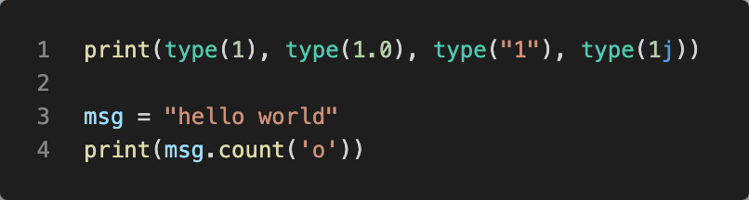
Class
Recall Lec. 3
数据类型 int, float, complex, str
Python中，不同类型type()就是不同的class
class: 把数据和函数打包在一起，就构成一个class。好处之一是：可以和其它的数据和函数隔离开
在三角形研究中，x, y, z 是三条边，可以定义三角形相关的函数
在代数问题中，x, y, z是多项式的变量，可以定义多项式相关的函数
为了避免同一文件中，可能的x, y, z冲突，用class将三角形和多项式分别打包为类，隔离开
class中的函数和变量属于这个类所特有，不会和外面的同名函数或者变量冲突
用法 x.func(parm)
. 表示func是x中的函数，不是其它地方的 (先学会用，具体原理在第9讲)
https://docs.python.org/3/library/math.html

Slide 8

Class and Object
类(class): 具有相同属性(attribute)和行为(method)的个体的集合
类的一个实例(instance)叫做对象(object)：
类和对象的关系: 集合与个体
中国人：姚明。球星：Messi。动物：狗。狗：哈士奇
Python自带的类: str, int, float, list, tuple, dict, set
a = “hello” # a 是str的一个对象(实例)
b = 123 # b 是int的一个对象
c = [1, -1, [1]] # c 是list的一个对象
d = {1, 2, 3} #d 是set的一个对象
类方法，所有对象都具有的方法(以txt = “hello world”为例)
txt.find(‘o’)
txt.count(‘l’)
同义词
属性、变量、成员变量
函数、方法、行为、成员函数
物以类聚，人以群分
类class，对象object，实例instance
类：打包封装 数据+函数

Slide 9
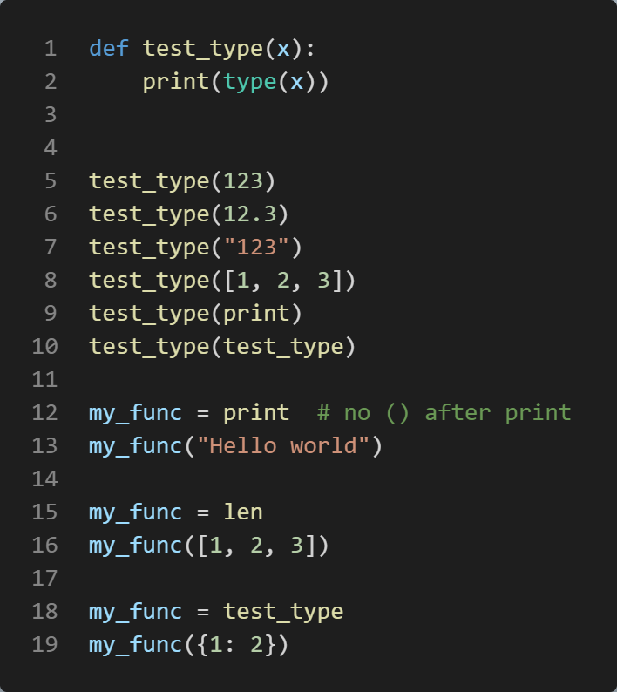
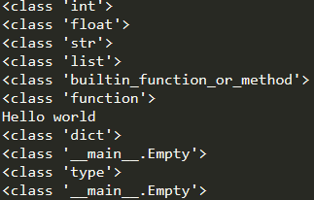
Class and Type
Values have their own types (class)
Variables are defined by “=”: assignment expression
The type of a variable could be changed in python
Functions are also a kind of data
Type == Class

Slide 10
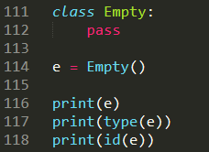

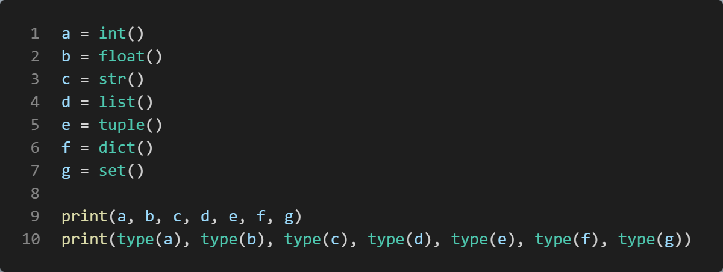
Keyword: class
规范：ClassName
class ClassName:
# begin your code here
Initialize an object: x = ClassName()
Class Empty is the simplest class. All its details are default by python

Slide 11
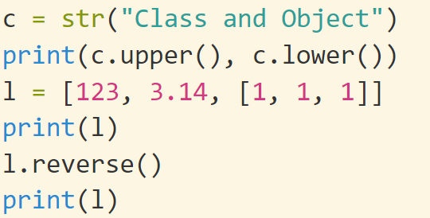
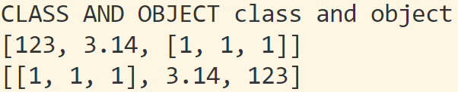
Class and Encapsulation (封装)
Class := attributes + methods
Attribute：属性(变量)，数据，例如三角形的三条边长度
Method：方法(函数)，处理数据的各种函数，例如计算面积，计算各个角度，计算外接圆、内切圆等等
area(), angles()……
class Triangle:
……
Usage of attributes and methods: object.attr or object.method()
x = Triangle() print(x.a) print(x.area())
y = Triangle() print(y.a) print(y.area())
(x, y 表明范围, a和area表明操作)
上海市.闵行区.东川路.800号
. : 表示从属关系

Slide 12
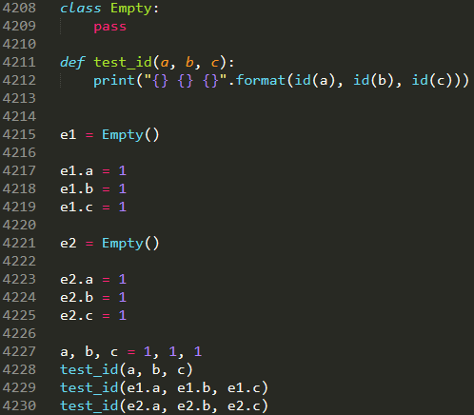
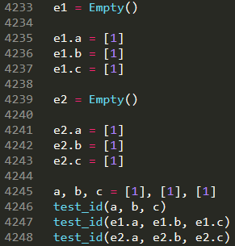



“.” operator
x.y: y is a variable inside the scope of x. “.” could distinguish x.y from the y outside x
x.y could also be defined by “=’
对象内部的属性和外部的属性互不干扰
对象之间的属性也互不干扰
Line 4215-4230，line 4233-4248: 1是不可修改对象，[1]是可修改对象，系统为了节约内存，有时候会共用不可修改对象。可修改对象一定不会共用
e1, e2 都通过“.”添加了内部的变量a, b, c. e3没有添加，所以e3报错
如果我们需要所有Empty的对象都自动具有a, b, c三个属性呢？？

Slide 13
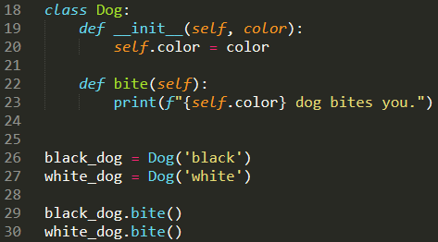

Class: Challenge
如何保证同一个类所有的对象都具有相同的属性和方法
class Dog：狗都有颜色，一双眼睛、四条腿，一条尾巴
每个狗都是单独的属性(数据)和方法(函数): 空间消耗
如何共享程序: 方法(函数)调用
red_dog, white_dog, red_dog.bite(), white_dog.bite()
调用bite()时，知道是white_dog还是red_dog
不同的对象互相不干扰，独立运行
如果bite()含有参数，知道是哪个参数
__init__(): 定义对象时， 自动运行
self: 类内部用来保存额外的信息，区分不同对象
Line 26, self = black_dog, 自动运行 __init__()
Line 27, self = white_dog, 自动运行 __init__()
Line 29, Line 30, 运行时可以正常区分开 white_dog 和 black_dog
black_dog.color
white_dog.color
权衡：引入一个新的机制往往也带来新的问题
构造函数__init__(): 保证统一性
self，用来区分不同对象

Slide 14
Class design: __init__(self) 构造函数
def __init__(self): “__init__(self)” is a reserved method in python classes.
All classes contain a __init__()
This method is called automatically (自动运行) when an object is created from the class and it allow the class to initialize the attributes of a class
It is known as a constructor (构造函数) in object oriented concepts.
Use the __init__() function to assign values to object properties, or other operations that are necessary to do when the object is being created
class ClassName
__init__(self, parameters)
……
__init__(): 以两个连续下划线“_ _” 开始和结束
init：initialization的缩写
Python中以__xxx__()形式的函数都具有特殊意义

Slide 15

Class: self
class ClassName
__init__(self, parameters)
……
self: myself, yourself, themselves ……
The first parameter in methods __init__(self) must be self
When define an object, self will point to that object
white_dog = Dog() # self = white_dog
black_dog = Dog() # self = red_dog
__init__()保证统一性，self保证唯一性, 不和其它对象冲突
类的定义在程序里面也只是一段代码，只有具体定义一个对象时，才会使用。Self保证了程序可以区分开是哪个对象 (white_dog or red_dog)
self不是keyword，可以用其它单词(this)代替它，但习惯上都用self.
第一个参数默认是self, __init__()没有参数会报错
定义对象的时候，不用用户传递self，系统会自己传递 (参数数量会少一个). 调用没有self的函数会报错
定义: x = ClassName()
隐含: self = x

Slide 16
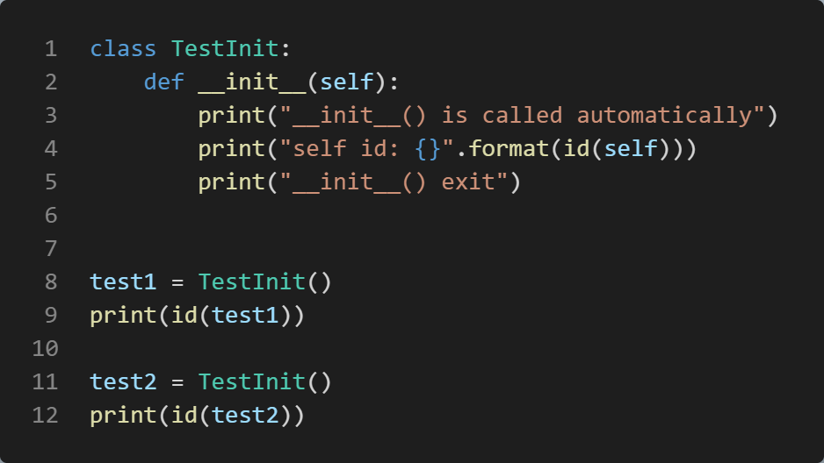
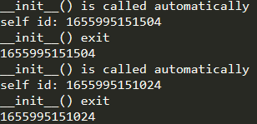
__init__() and self
1. __init__()被在对象创建时，被自动调用
2. 定义: x = ClassName()
隐含: self = x
对象和对象之间会共享函数，所以self保证了函数运行的互不干扰
self在对象调用函数时，不用传递。已经默认知道了

Slide 17
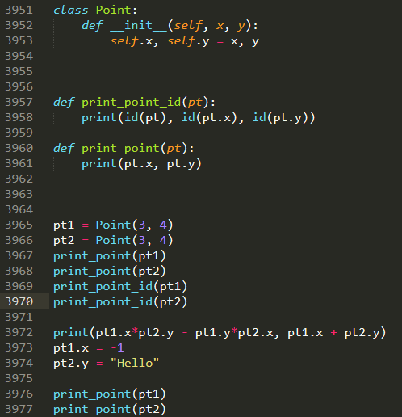


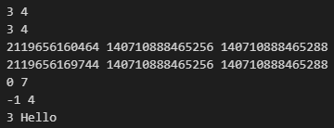
Member Attributes
3953：”=” 定义变量
3965： self = pt1
3966: self = pt2
x, y是参数，self.x和self.y 表示将定义的对象的x 和y
Line 3965, 3966只有两个参数
Line 3965—3970, pt1 and pt2 have the same position. Their address are different
Line 3972—3977, you may use the attributes like general variables
Line 3952 Vs. Line 3965, __init__ has 3 parameters. When initialize an object, self is not needed
__init__ will be called when the object is created

Slide 18
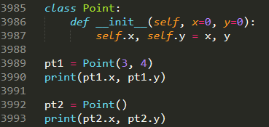

Class Point: default parameters

Slide 19
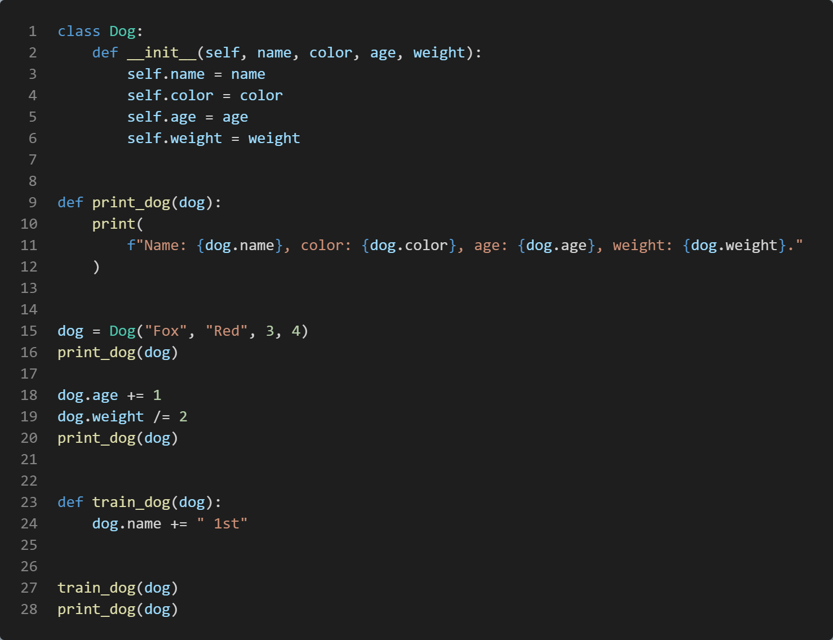



Class Dog

Slide 20
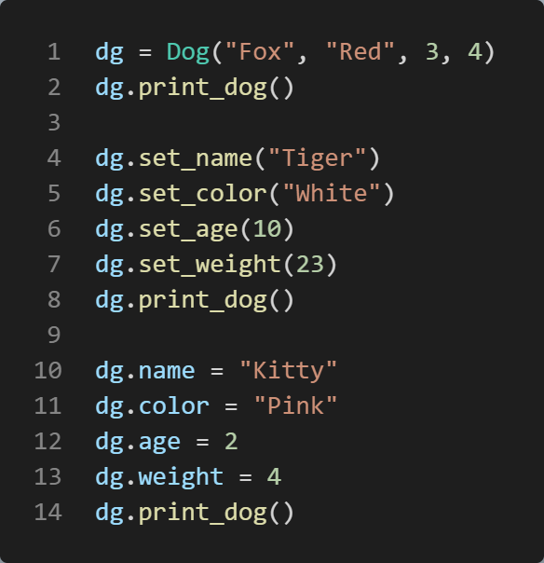
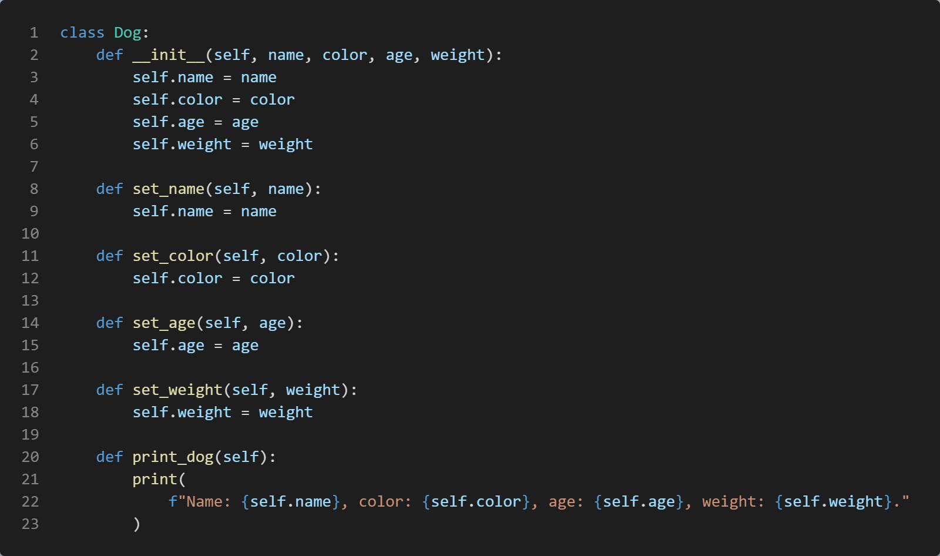

Member functions
不建议10-14这种写法
Member functions: the same with the general function definition, except that the first parameter should be self
When called member functions, self is omitted

Slide 21
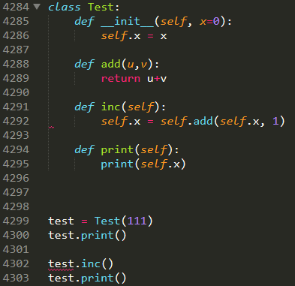
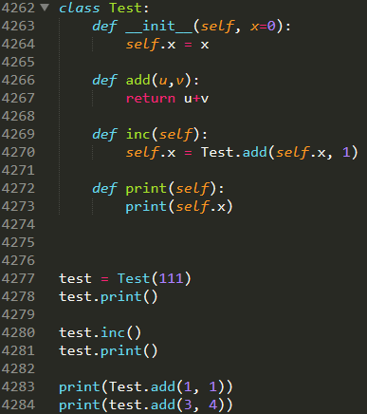

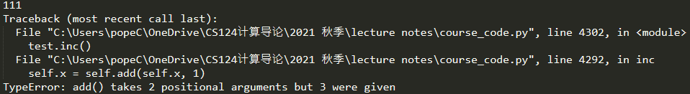
Member functions: no self
Member functions without self cannot be called by an object, but called inside the class implementation via: ClassName.func()
Line 4288, u=self
Line 4284, error: add is not a function of self

Slide 22
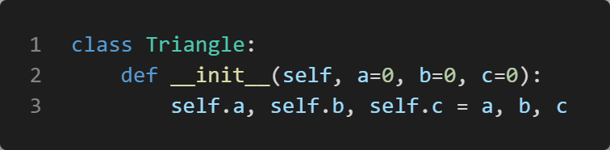
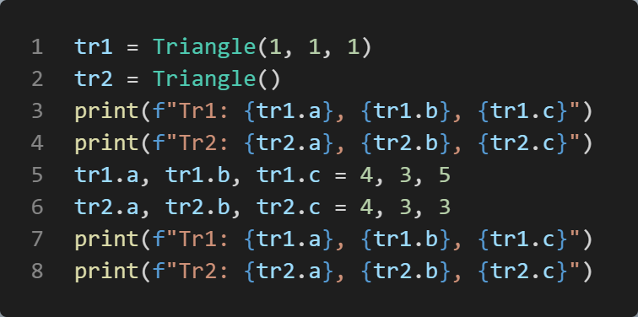
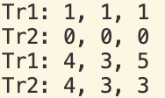
class Triangle, self
同一个类的不同对象
属性、方法独立，互相不干扰
__init__: 表明所有的Triangle对象都有a, b, c三个属性，并且默认为0
Q: 为什么有个self？为什么__init__()有四个参数，而tr1, tr2定义时只传递了三个参数
不同对象的属性，保存在不同的内存位置: tr1.a, tr2.a
为了节省内存空间。同一类的不同对象，共享方法(函数)的空间。执行的时候，都是跳转到同一段代码。问题：严重干扰，如何区分a是属于tr1还是tr2
self是一个隐藏参数，当定义对象时，self被自动指向该对象
tr1 = Triangle(1,1,1) # 系统默认 self=tr1
tr2 = Triangle() #系统默认 self=tr2
类的方法调用的时候，self会自动传递过去
没有self的函数无法使用，使用会报错：参数数量不匹配
在类中使用属性和方法时，前面必须加self: self.xxx, self.xxx()
self.x 和x，self.f()和f()是不同的方法和属性
tr1, tr2是两个独立的对象，虽然属于同一个类
Tr1, tr2的属性和方法都可以直接使用，和普通变量一样
. 运算符：表明作用范围

Slide 23
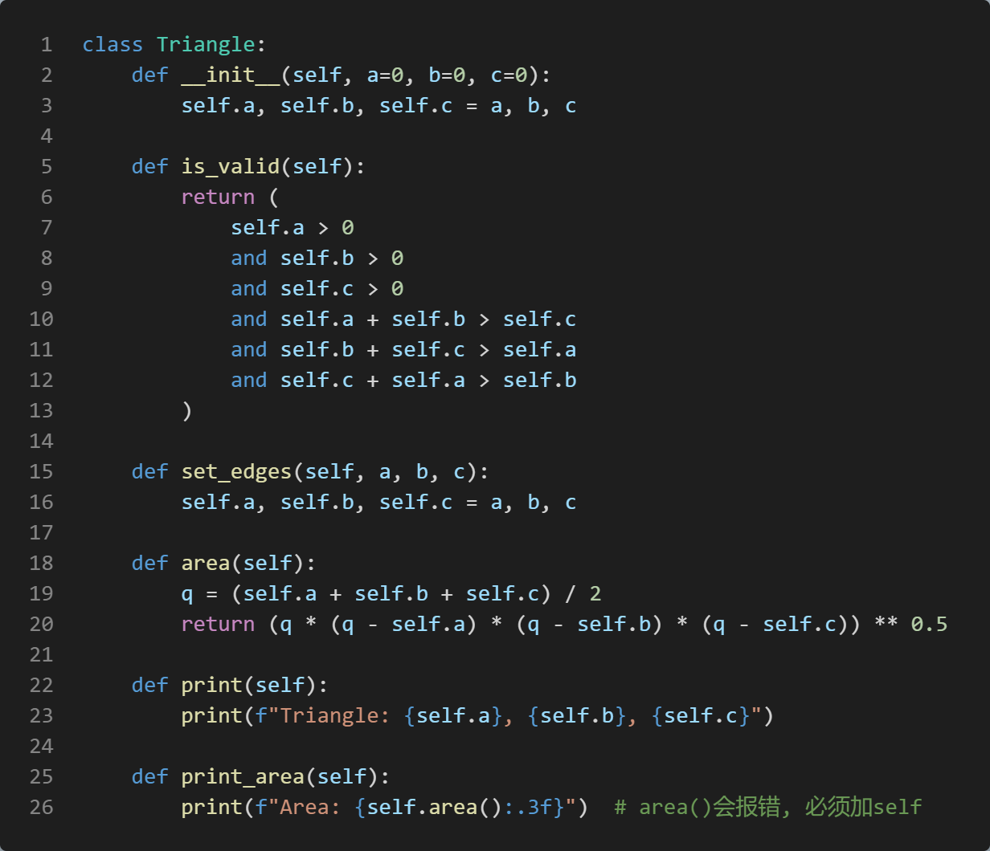
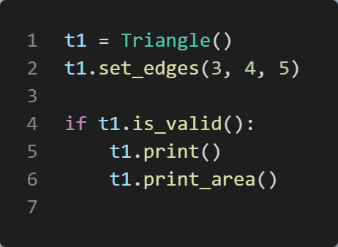

class Triangle
1. 类的成员函数和普通函数的定义一样，除了第一个参数是self
2. 类方法的执行规律和普通函数一样， 除了不需要传递self进去
3. 函数内使用成员属性，必须加self.
使用类自己的函数或者属性时，必须加self

Slide 24
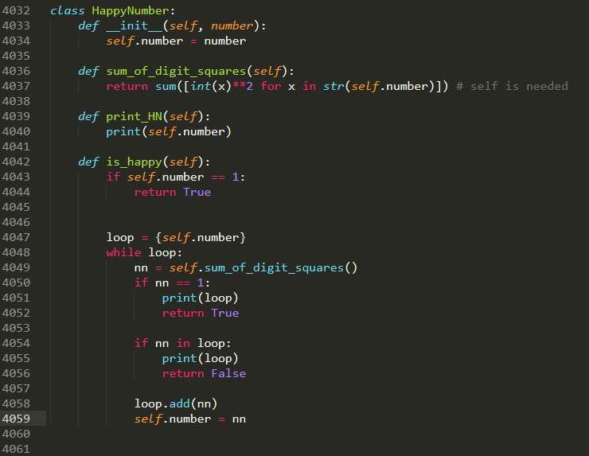
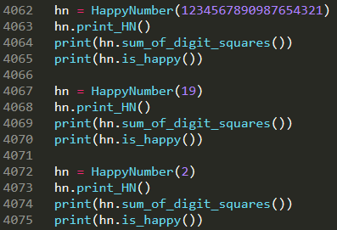
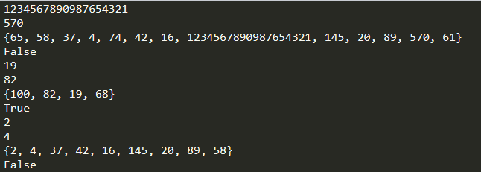
Class HappyNumber
A happy number is a number defined by the following process:
Starting with any positive integer, replace the number by the sum of the squares of its digits.
Repeat the process until the number equals 1 (where it will stay), or it loops endlessly in a cycle which does not include 1.
Those numbers for which this process ends in 1 are happy.

Slide 25
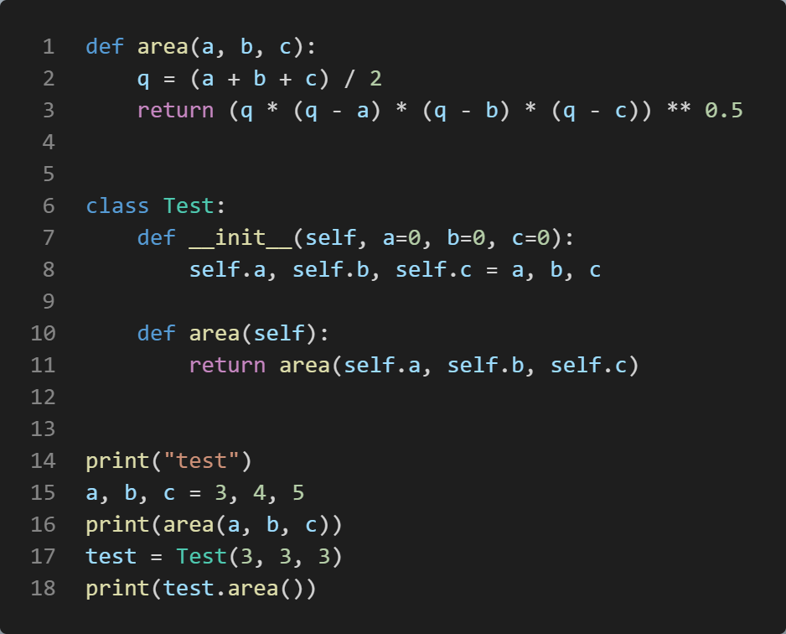

Scope of functions and variables
area()和xxx.area()是两个函数
类里面的函数要加self
不同作用范围的两个物体是隔离的

Slide 26
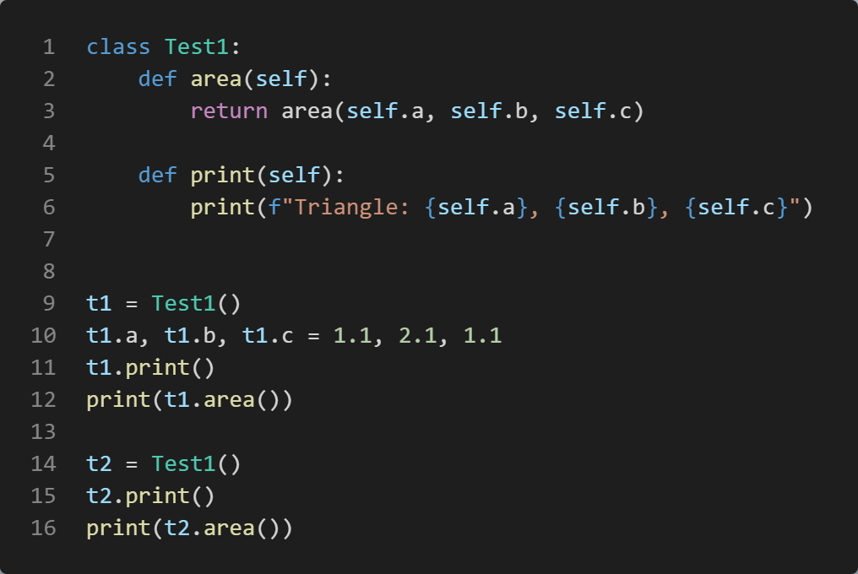
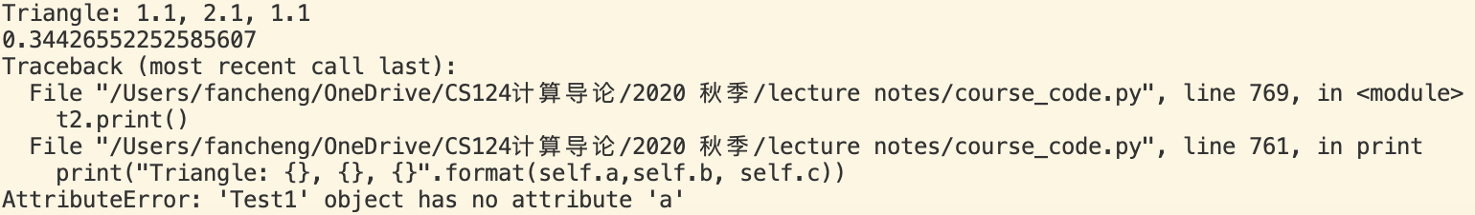
Without __init__
没有__init__()函数
类Test1的对象没有共同的属性
Python自动推导变量的类型
t1有自己的的属性a, b, c
t2没有属性a, b, c

Slide 27
Python classes/objects
Python is an object oriented programming language
Almost everything in Python is an object, with its properties and methods
A Class is like an object constructor, or a "blueprint" for creating objects
Procedural programming paradigm: write functions that operate data
Python is an object-oriented Programming (OOP) Language
OOP has its root in 1960s. In 1980s, it became the main programming paradigm
Rapid growing software size and complexity
The focus is object that contains both data and functionality
Each object definition corresponds to some object or concept in the real world, and the functions that operate on that object correspond to the ways real-world objects interact
Commonly known OO Languages: C++, Java, Python
Class and object
For more details: https://en.wikipedia.org/wiki/Object-oriented_programming
如果没有OO，所有东西都写在一起?

Slide 28
Exercise
实现Triangle类
实现vector类
属性：一个n维的list
方法
长度length(self)
print_length()
方向angle(self)
Print_angle()
点积dot(self, other)
伸缩scale(self, ratio)

Slide 29
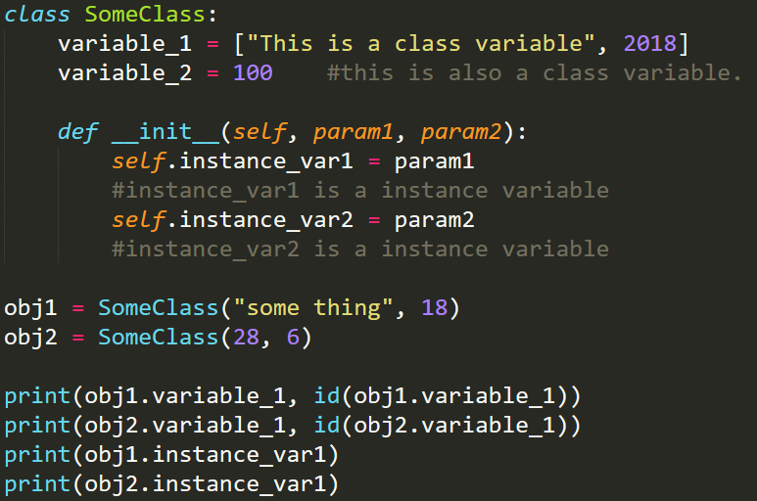
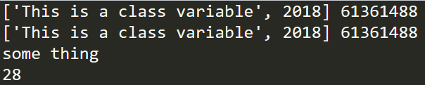
Class Variables
In general, instance variables are for data unique to each instance
class variables are for attributes shared by all instances of the class
类变量 Vs. 对象变量
所有人都有自己的姓名(instance)，但只有一个国籍(class)

Slide 30
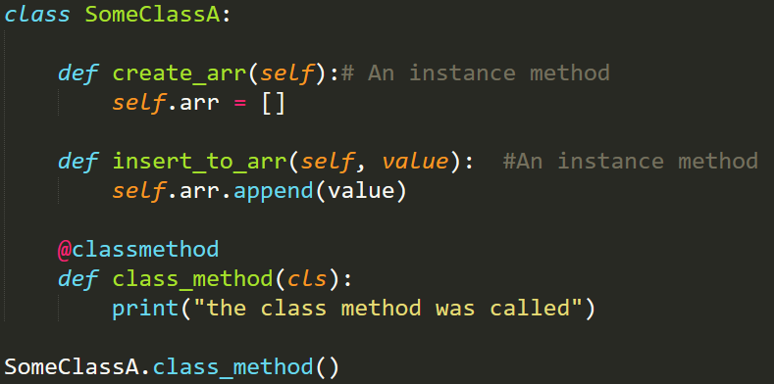
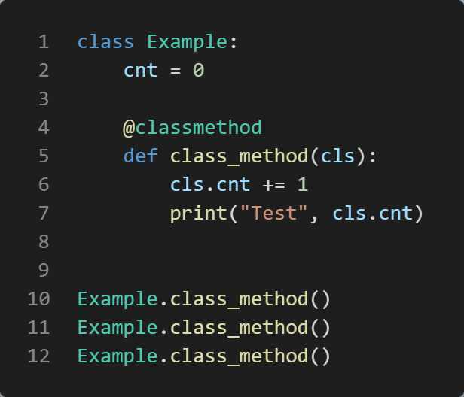

Class Methods
Class methods are methods shared by all instances of the class.
Without even instantiating an object, we can access class methods

Slide 31
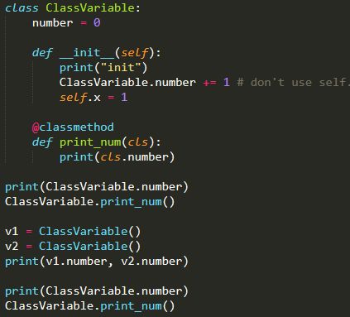

Class Variable and Class method
Instance variables/methods are owned by the instance itself. No interference!
You must define an instance first to use them
Class variables/methods are shared by all instances of the class
To use a class variables/methods, you don’t need to define an instance first
类对象/函数实例化之前就可以使用
Classname.xxx
类属性/方法：类的所有对象共享同一份
不用实例化对象
实例属性/方法：各个对象各有一份

Slide 32
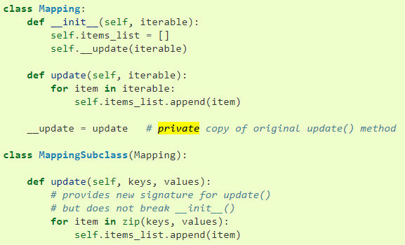
Private Methods _, __
“Private” instance variables that cannot be accessed except from inside an object don’t exist in Python
However, there is a convention that is followed by most Python code:
a name prefixed with an underscore (e.g. _spam) should be treated as a non-public part of the API (whether it is a function, a method or a data member). It should be considered an implementation detail and subject to change without notice
To define a private method prefix the member name with the double underscore “__”
The double underscore "__" does not mean a "private variable". You use it to define variables which are "class local" and which can not be easily overridden by subclasses. It mangles the variables name.
For example:
class A(object):
def __init__(self):
self.__foobar = None # Will be automatically mangled to self._A__foobar
class B(A):
def __init__(self):
self.__foobar = 1 # Will be automatically mangled to self._B__foobar
https://stackoverflow.com/questions/1641219/does-python-have-private-variables-in-classes
non-public: 不建议(禁止)使用

Slide 33
Inheritance

Slide 34

Evolution and Inheritance (继承)
软件的生命周期： 开发、部署、维护
Inheritance: Classes can inherit from other classes
A class can inherit attributes and behaviour methods from another class, called the superclass (超类). Superclasses are sometimes called ancestors as well
A class which inherits from a superclass is called a subclass (子类), also called heir class or child class
Evolution: Subclass may have their own attributes and methods
Inheritance and Evolution — polymorphism

Slide 35
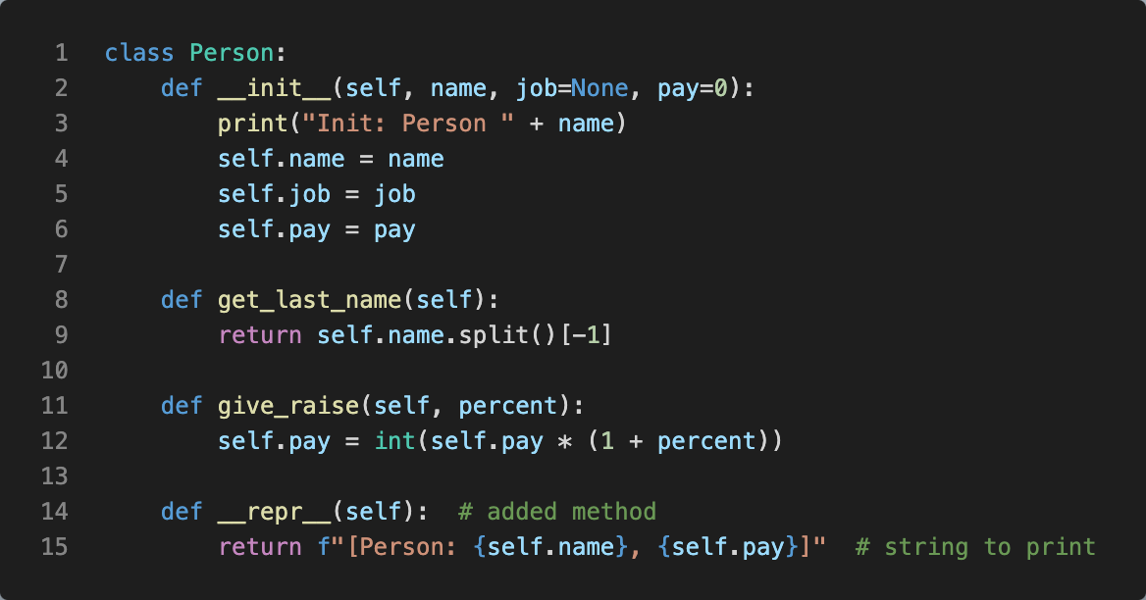
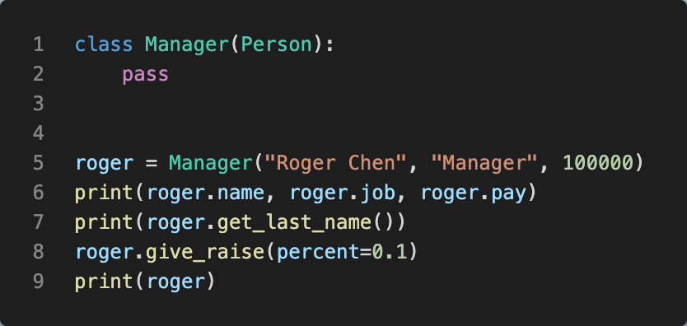
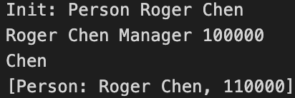
Inheritance Syntax
The syntax for a subclass definition looks like this:
class DerivedClassName(BaseClassName1, BaseClassName2, … ):
Person类
属性：name, job, pay
方法：get_last_name(), give_raise(), __repr__()
__str__() for print()
Manager类
继承Person: 具有Person的所有属性和方法
自己的方法和属性
继承：拥有超类所有的属性和方法

Slide 36
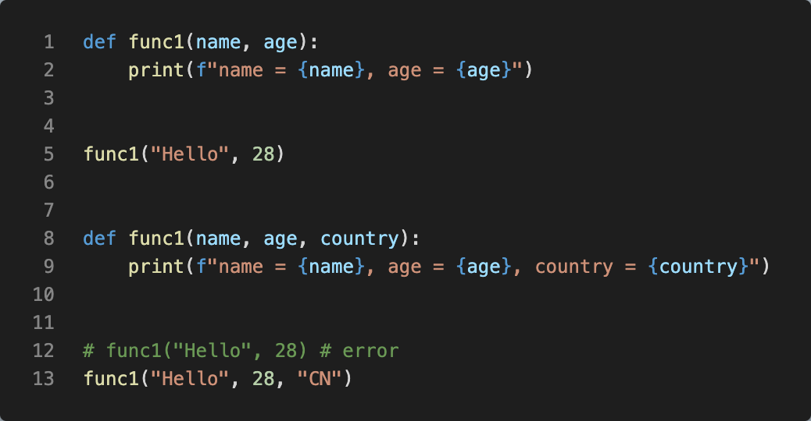

Functions with the same name
Lec. 4
Python中，函数必须在使用前定义
Python中，两个同名函数， 无论参数是否相同，后面的函数会覆盖前面的函数。即，python中没有重载，只有重写

Slide 37
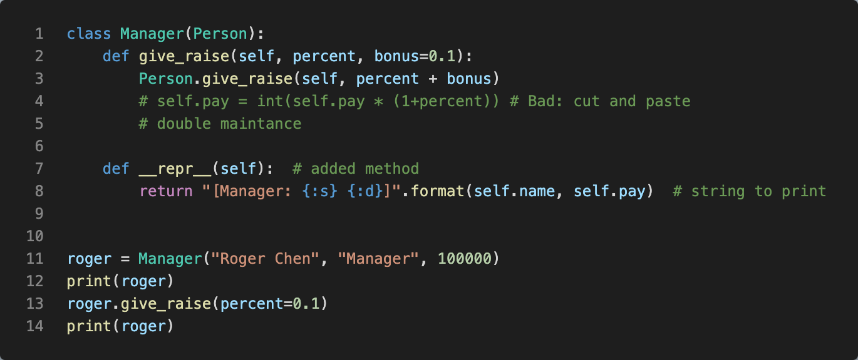
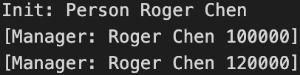
Overriding (重写)
Method overriding is an object-oriented programming feature that allows a subclass to provide a different implementation of a method that is already defined by its superclass or by one of its superclasses
The implementation in the subclass overrides the implementation of the superclass by providing a method with the same name as the method of the parent class
没有return
super().giveRaise()可以起到和Person.giveRaise()相同的功能，但是不推荐用super()
Person.giveRaise()比super更清晰
一个类可以继承多个类，super()有歧义
重写：子类覆盖超类
“年轻人有自己的想法”
很少这么做

Slide 38
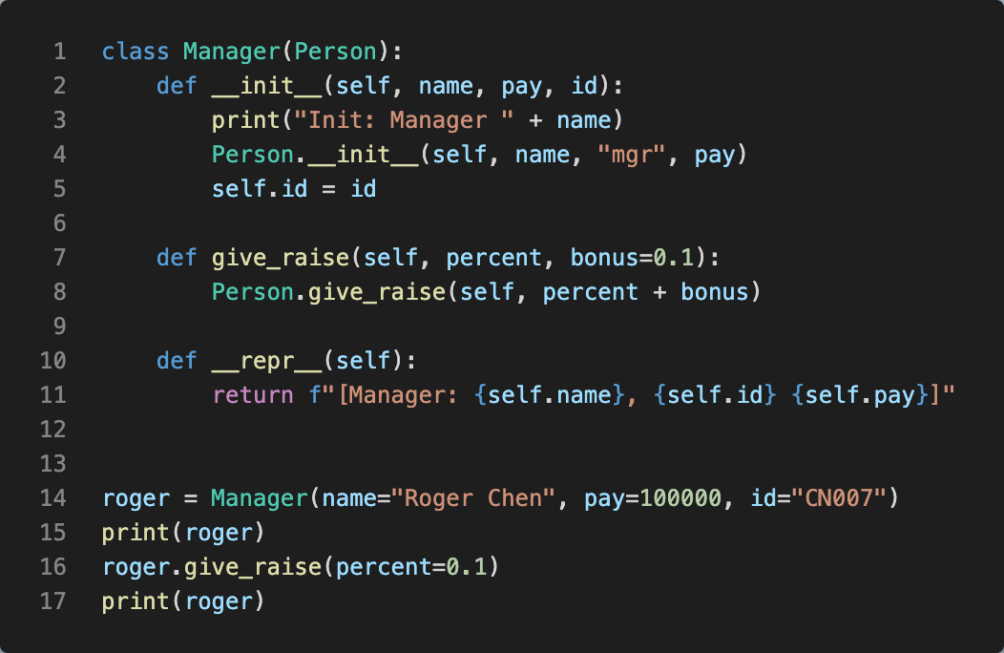

Overriding __init__()
To add new members to the attributes.
注意：删除Person.__init__(self, name, 'mgr', pay)则manager将没有name, job, pay.
必须先调用父类的__init__()

Slide 39
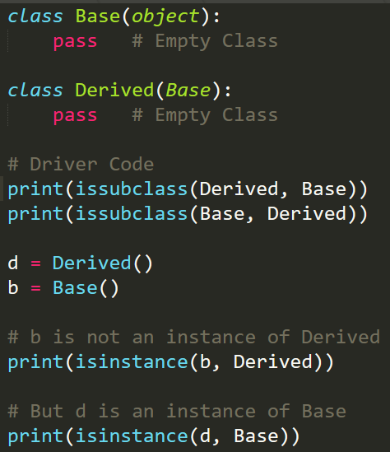

issubclass() and isinstance()
Python (from version 3.x), object is root of all classes.
Python provides a function issubclass() that directly tells us if a class is subclass of another class. isinstance() will tell us if a variable is an object of a class

Slide 40
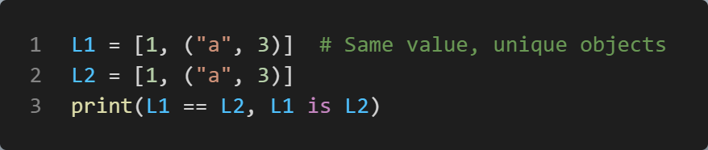
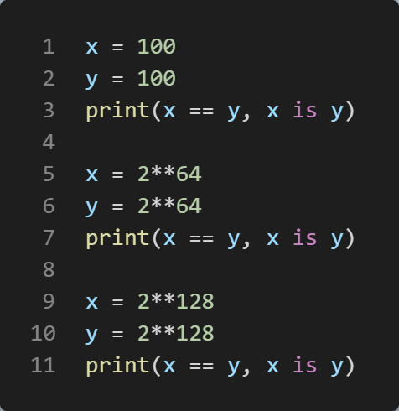
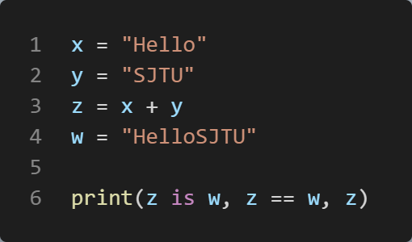

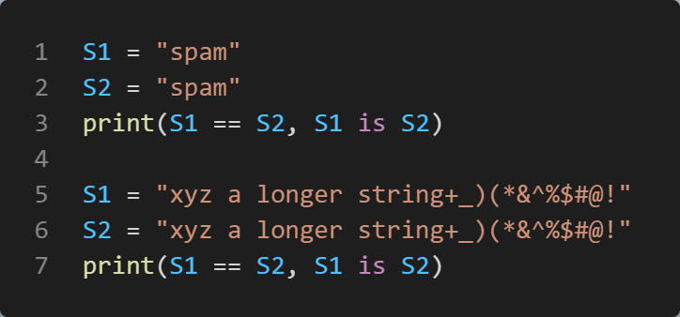




==(值) VS. is(值和id)
The == operator tests value equivalence. Python performs an equivalence test, comparing all nested objects recursively
The is operator tests object identity (身份证). Python tests whether the two are really the same object (i.e., live at the same address in memory)
False True HelloSJTU
is 依赖于系统

Slide 41



Introspection Tools
Special attributes and functions that give us access to some of the internals of objects’ implementations.
The built-in instance.__class__ (属于哪个类)attribute provides a link from an instance to the class from which it was created. Classes in turn have a __name__(类的名字), and a __bases__ sequence that provides access to superclasses.
The built-in object.__dict__(属性) attribute provides a dictionary with one key/value pair for every attribute attached to a namespace object (including modules, classes, and instances). (dir() for functions)

Slide 42
object class
Python (from version 3.x), object is root of all classes.
所有的类都继承了object类
类定义的头 class ClassName, 其实是 class ClassName (object):
所有的对象都可以调用 len(), print(), id(), type()
object.__len__(self)
object.__str__(self): Called by str(object) and the built-in functions format() and print() to compute the “informal” or nicely printable string representation of an object. The return value must be a string object
（返回字符串）
如何让自定义的类能够使用基本的运算符： +,-,*,/, +=, >=, 等等
object.__lt__(self, other) # x<y lt: less than
object.__le__(self, other) # x<=y less equal
object.__eq__(self, other) # x==y equal
object.__ne__(self, other) # x!=y not equal
object.__gt__(self, other) # x>y greater than
object.__ge__(self, other) # x>=y greater equal
These are the so-called “rich comparison” methods. The correspondence between operator symbols and method names is as follows:
x<y calls x.__lt__(y),
x<=y calls x.__le__(y),
x==y calls x.__eq__(y),
x!=y calls x.__ne__(y),
x>y calls x.__gt__(y),
x>=y calls x.__ge__(y)
https://docs.python.org/3/reference/datamodel.html

Slide 43



Triangle: overloading object
See P23
此处的大小关系是自定义的

Slide 44


[]: __getitem__, __setitem__
To access an element via its index
__getitem__(self, index)
__setitem__(self, index, value)

Slide 45


+, +=
__add__: y = x + 1
__radd__: z = -9 + x
__iadd__: x += 100

Slide 46


repr(): __repr__(), __str__()
__str__() inside class X will be used for print(x)
__repr(object)__: Called by the repr() built-in function and by string conversions (reverse quotes) to compute the “official” string representation of an object
This is typically used for debugging, so it is important that the representation is information-rich and unambiguous.
In short, the goal of __repr__ is to be unambiguous and __str__ is to be readable.
如果没有定义__str__, 将自动使用__repr__，如果有__str__，则默认情况下不使用__repr__
My rule of thumb: “__repr__ is for developers, __str__ is for customers.”
__repr__比__str__包含更多的信息
Repr：reproduce,包含更多信息
https://stackoverflow.com/questions/1436703/difference-between-str-and-repr
https://docs.python.org/3.8/reference/datamodel.html

Slide 47


All are Object
Functions are also objects
dir(func)
func.__name__
func.__code__

Slide 48

Duck Typing
“If it walks like a duck, and it quacks like a duck, then it must be a duck.”
Duck typing is a concept related to dynamic typing, where the type or the class of an object is less important than the methods it defines. When you use duck typing, you do not check types at all. Instead, you check for the presence of a given method or attribute
Duck typing is a concept that says that the “type” of the object is a matter of concern only at runtime and you don’t need to explicitly mention the type of the object before you perform any kind of operation on that object, unlike normal typing where the suitability of an object is determined by its type
In Python, we have the concept of Dynamic typing i.e. we can mention the type of variable/object later. The idea is that you don’t need a type in order to invoke an existing method on an object if a method is defined on it, you can invoke it.
鸭子类型是与动态类型相关的概念，其中对象的类型或类不如它定义的方法重要。当您使用鸭子类型时，您根本不会检查类型。相反，您可以检查给定方法或属性是否存在
鸭子类型是一个概念，它表示对象的“类型”仅在运行时才是一个关注的问题，在对该对象执行任何类型的操作之前，您不需要显式提及对象的类型，这与普通类型不同，在普通类型中，对象的适用性由其类型决定
在 Python 中，我们有动态类型的概念，即我们可以稍后提及变量/对象的类型。这个想法是，如果在对象上定义了方法，则不需要类型即可调用对象上的现有方法，您可以调用它。

Slide 49




Polymorphism (多态)
Polymorphism in Computer Science is the ability to present the same interface for differing underlying forms. We can have in some programming languages polymorphic functions or methods, for example. Polymorphic functions or methods can be applied to arguments of different types, and they can behave differently depending on the type of the arguments to which they are applied.
计算机科学中的多态性是为不同的底层形式提供相同接口的能力。例如，我们可以在某些编程语言中使用多态函数或方法。多态函数或方法可以应用于不同类型的参数，并且它们的行为可能因应用它们的参数的类型而异。
Object: len, print, type, id
__str__() for print()
多态：根据不同的参数类型，运行时自动调用相应的方法，
不用重复编写相同的代码

Slide 50


Machinery of attribute inheritance
Classes support factoring and customization of code better than any other language tool we’ve seen so far.
they allow us to minimize code redundancy (and so reduce maintenance costs) by factoring operations into a single, shared implementation;
they allow us to program by customizing what already exists, rather than changing it in place or starting from scratch.
类比我们目前看到的任何其他语言工具都更好地支持代码的分解和自定义。
它们允许我们通过将操作分解到单个共享实现中来最大限度地减少代码冗余（从而降低维护成本）;
它们允许我们通过自定义已经存在的内容进行编程，而不是就地更改它或从头开始。

Slide 51
Machinery of attribute inheritance
Superclasses are listed in parentheses in a class header.
To make a class inherit attributes from another class, just list the other class in parentheses in the new
Classes inherit attributes from their superclasses.
Just as instances inherit the attribute names defined in their classes, classes inherit all of the attribute names defined in their superclasses
Instances inherit attributes from all accessible classes.
Each instance gets names from the class it’s generated from, as well as all of that class’s superclasses.
When looking for a name, Python checks the instance, then its class, then all superclasses.
Each object.attribute reference invokes a new, independent search.
Python performs an independent search of the class tree for each attribute fetch expression.
Logic changes are made by subclassing, not by changing superclasses.
By redefining superclass names in subclasses lower in the hierarchy (class tree), subclasses replace and thus customize inherited behavior
超类列在类头的括号中。
要使一个类继承另一个类的属性，只需在新的括号中列出另一个类
类从其超类继承属性。
正如实例继承其类中定义的属性名称一样，类继承其超类中定义的所有属性名称
实例从所有可访问的类继承属性。
每个实例都从生成它的类以及该类的所有超类中获取名称。
在查找名称时，Python 会检查实例，然后检查其类，然后检查所有超类。
每个 object.attribute 引用都会调用一个新的独立搜索。
Python 对每个属性提取表达式的类树执行独立搜索。
逻辑更改是通过子类化进行的，而不是通过更改超类来实现的。
通过在层次结构（类树）中较低的子类中重新定义超类名称，子类可以替换并因此自定义继承的行为。

Slide 52

Inheritance Tree
Instance attributes are generated by assignments to self attributes in methods
Class attributes are created by statements (assignments) in class statements
Superclass links are made by listing classes in parentheses in a class statement header
实例属性是通过对方法中的 self 属性的赋值生成的
类属性由类语句中的语句（赋值）创建
超类链接是通过在类语句头的括号中列出类来建立的
The net result is a tree of attribute namespaces that leads from an instance, to the class it was generated from, to all the superclasses listed in the class header. Python searches upward in this tree, from instances to superclasses
最终结果是属性命名空间树，该树从实例到生成它的类，再到类头中列出的所有超类。Python 在此树中向上搜索，从实例到超类

Slide 53






Multiple inheritance 多重继承
Sub class may inherit several sup class
Questions:
super()的困扰
Chapter 31: Designing with Classes
P. 956 Multiple Inheritance: “Mix-in” Classes
A
仅供了解
MRO
BFS
B
C
D

Slide 54
Example
Triangle
Vector
Point2D
nDPoint
ComplexNumber
Happy Number
Isomorphic String

Slide 55
Reading
Learning Python: Part VI. Class and OOP
[]
for
……
Super() P. 1403
体会class的优点：代码界限清晰，互相不干扰；接口统一，配合方便
除了实现上层类的接口，一般不要用继承
不需要死记，要用的时候再翻看手册

Slide 56
Module

Slide 57
The big picture
Python module:
the highest-level program organization unit, which packages program code and data for reuse, and provides self contained namespaces that minimize variable name clashes across your programs.
In concrete terms, modules typically correspond to Python program files:
Each file is a module, and modules import other modules to use the names they define.
Modules are processed with two statements and one important function:
import: Lets a client (importer) fetch a module as a whole
from: Allows clients to fetch particular names from a module
imp.reload (reload in 2.X): Provides a way to reload a module’s code without stopping Python)（重载模块）
In short, modules provide an easy way to organize components into a system by serving as self-contained packages of variables known as namespaces (名空间).
一个单独的文件就是一个module

Slide 58




import
import math
print(math.sin(math.pi/3))
语法：import moduleName
由于moduleName就是文件名，所以python的文件名必须符合python的变量定义规则
在文件b.py中定义函数spam(). 在文件a.py中import b并且调用b.spam(). 运行a.py
在文件my_geometry.py中定义Triangle类. 在另一文件中import并运行
b.py和my_geometry.py都是python文件
都可以作为module导入(import)

Slide 59
Top-level file (顶层文件)
模块之间import，其执行顺序和函数调用类似
At a base level, a Python program consists of text files containing Python statements, with
one main top-level file (当前运行的文件)
zero or more supplemental files known as modules (被import的文件)
The top-level (a.k.a. script) file contains the main flow of control of your program—this is the file you run to launch your application.
The module files are libraries of tools used to collect components used by the top-level file, and possibly elsewhere. Top-level files use tools defined in module files, and modules use tools defined in other modules.
A file imports a module to gain access to the tools it defines, which are known as its attributes—variable names attached to objects such as functions. Ultimately, we import modules and access their attributes to use their tools.
import math
math.pi
math.sin(x)
Top-level: 自己当家作主，调用其他模块
Imported module: 打工人

Slide 60

Python Program Architecture
Program architecture in Python.
A program is a system of modules
one top-level (顶层) script file (launched to run the program)
and multiple module files (imported libraries of tools)
Scripts and modules are both text files containing Python statements, though the statements in modules usually just create objects to be used later
Python’s standard library provides a collection of precoded modules

Slide 61
Python Program Architecture: import
The file a.py is chosen to be the top-level file; it will be a simple text file of statements, which is executed from top to bottom when launched.
The files b.py and c.py are modules; they are simple text files of statements as well, but they are not usually launched directly. Instead, as explained previously, modules are normally imported by other files that wish to use the tools the modules define
The first of these, a Python import statement, gives the file a.py access to everything defined by top-level code in the file b.py.
The code import b roughly means:
Load the file b.py (unless it’s already loaded), and give me access to all its attributes through the name b.
In fact, the module name used in an import statement serves two purposes: it identifies the external file to be loaded, but it also becomes a variable assigned to the loaded module.
The code b.spam means:
Fetch the value of the name spam that lives within the object b.

Slide 62



import
Objects defined by a module are also created at runtime, as the import is executing:
import literally runs statements in the target file one at a time to create its contents.
被import的文件的每一条语句都会被执行一遍

Slide 63

How import works
They are really runtime operations that perform three distinct steps the first time a program imports a given file:
1. Find the module’s file.
2. Compile it to byte code (if needed). Byte Code Files: __pycache__ in Python
3. Run the module’s code to build the objects it defines.

Slide 64
The module search path
import时寻找模块的步骤
The home directory of the program
PYTHONPATH directories (if set)
Standard library directories
The contents of any .pth files (if present)
The site-packages home of third-party extensions

Slide 65


import, from … import
import moduel1
module1.printer(‘Hello world!’)
from moduel1 import printer
printer('Hello world!’)
from module1 import *
printer('Hello world!’)
*：通配符，代表“所有，全部，任意”
vs code和Jupyter有差异，以vs code为准
from xxx import xxx的文件的每一条语句也都会被执行一遍

Slide 66



Import Happen Only Once
Modules are loaded and run on the first import or from, and only the first.
This is on purpose—because importing is an expensive operation, by default Python does it just once per file, per process. Later import operations simply fetch the already loaded module object.
模块在第一次导入或从时加载并运行，并且仅在第一次导入时加载和运行。
这是故意的，因为导入是一项成本高昂的操作，因此默认情况下，Python 对每个文件、每个进程只执行一次。稍后的导入操作只是获取已加载的模块对象。

Slide 67
Import and from
At least conceptually, a from statement like this one:
from module import name1, name2 # Copy these two names out (only)
is similar to this statement sequence:
import module # Fetch the module object
name1 = module.name1 # Copy names out by assignment
name2 = module.name2
del module # Get rid of the module name
Like all assignments, the from statement creates new variables in the importer, which initially refer to objects of the same names in the imported file. Only the names are copied out, though, not the objects they reference, and not the name of the module itself. When we use the from * form of this statement (from module import *), the equivalence is the same, but all the top-level names in the module are copied over to the importing scope this way.

Slide 68
Reload modules
In a nutshell:
Imports (via both import and from statements) load and run a module’s code only the first time the module is imported in a process
Later imports use the already loaded module object without reloading or rerunning the file’s code
The reload function forces an already loaded module’s code to be reloaded and rerun（reload 函数强制重新加载并重新运行已加载模块的代码）
Unlike import and from:
reload is a function in Python, not a statement.
reload is passed an existing module object, not a new name.
reload lives in a module in Python 3.X and must be imported itself.(reload 位于 Python 3.X 的模块中，必须自行导入。)
from imp import reload
reload(moduleName)

Slide 69
as (别名)
import modulename as name # And use name, not modulename
is equivalent to the following, which renames the module in the importer’s scope only (it’s still known by its original name to other files):(重命名模块)
import modulename
name = modulename
del modulename # Don't keep original name
After such an import, you can—and in fact must—use the name listed after the as to refer to the module. This works in a from statement, too, to assign a name imported from a file to a different name in the importer’s scope; as before you get only the new name you provide, not its original: （在进行此类导入后，您可以（实际上必须）使用 as 后面列出的名称来指代模块。这也适用于 from 语句，用于将从文件导入的名称分配给导入器作用域中的其他名称;和以前一样，您只获得您提供的新名称，而不是其原始名称：）
from modulename import attrname as name
import reallylongmodulename as name # Use shorter nickname
name.func()
from module1 import utility as util1 # Can have only 1 "utility”
from module2 import utility as util2
util1()
util2()
import numpy as np

Slide 70
__future__
Changes to the language that may potentially break existing code are usually introduced gradually in Python. They often initially appear as optional extensions, which are disabled by default. To turn on such extensions, use a special import statement of this form:
from __future__ import featurename
When used in a script, this statement must appear as the first executable statement in the file (possibly following a docstring or comment), because it enables special compilation of code on a per-module basis. It’s also possible to submit this statement at the interactive prompt to experiment with upcoming language changes; the feature will then be available for the remainder of the interactive session.
对可能破坏现有代码的语言的更改通常在 Python 中逐渐引入。它们最初通常显示为可选扩展，默认情况下处于禁用状态。若要启用此类扩展，请使用以下格式的特殊 import 语句：
from __future__导入 featurename
在脚本中使用时，此语句必须显示为文件中的第一个可执行语句（可能在文档字符串或注释之后），因为它可以基于每个模块对代码进行特殊编译。也可以在交互式提示下提交此语句，以尝试即将到来的语言更改;然后，该功能将在交互式会话的其余部分可用。
必须第一行
列子：在py2.0环境下使用py3.0的语法

Slide 71
__name__ and __main__
Top-level: 自己当家作主，调用其他模块
Imported module: 打工人
Both import a file as a module and run it as a standalone program, is widely used in Python files.
Each module has a built-in attribute called __name__, which Python creates and assigns automatically as follows:
If the file is being run as a top-level program file, __name__ is set to the string "__main__" when it starts.
If the file is being imported instead, __name__ is set to the module’s name as known by its clients.
The upshot is that a module can test its own __name__ to determine whether it’s being run or imported.
In effect, a module’s __name__ variable serves as a usage mode flag, allowing its code to be leveraged as both an importable library and a top-level script.
将文件作为模块导入并将其作为独立程序运行，在 Python 文件中被广泛使用。
每个模块都有一个名为 __name__ 的内置属性，Python 会自动创建和分配该属性，如下所示：
如果文件作为顶级程序文件运行，则__name__启动时设置为字符串“__main__”。
如果改为导入文件，则__name__将设置为其客户端已知的模块名称。
结果是，模块可以测试自己的__name__，以确定它是正在运行还是导入。
实际上，模块的 __name__ 变量充当使用模式标志，允许其代码用作可导入库和顶级脚本。

Slide 72




Top-level Vs. Imported

Slide 73



import
Imports are always put at the top of the file, just after any module comments and docstrings, and before module globals and constants.
Imports should be grouped in the following order:
Standard library imports.
Related third party imports.
Local application/library specific imports.
You should put a blank line between each group of imports.
Absolute imports are recommended, as they are usually more readable and tend to be better behaved
Wildcard imports (from <module> import *) should be avoided
导入始终放在文件顶部，紧挨着任何模块注释和文档字符串之后，以及模块全局变量和常量之前。
导入应按以下顺序分组：
标准库导入。
相关的第三方导入。
特定于本地应用程序/库的导入。
您应该在每组导入之间留一个空行。
建议使用绝对导入，因为它们通常更具可读性，并且往往表现得更好
应避免通配符导入（来自<module>导入 *）
From Lec. 8

Slide 74
Must Know Useful Module
Top 2
Matplotlib : plot figures
Numpy: numerical computing
Others
Scipy: scientific computing
Pandas: data analysis
Scrapy: Crawler
Beautiful soup: pulling data out of HTML and XML files
Game
Pygame: pip3 install pygame
To see if it works, run one of the included examples:
python3 -m pygame.examples.aliens
Scipy：科学计算
熊猫：数据分析
Scrapy：爬虫
美丽的汤：从 HTML 和 XML 文件中提取数据
游戏
pygame： pip3 安装 pygame
若要查看它是否有效，请运行包含的示例之一：
python3 -m pygame.examples.aliens
画图
数值运算

Slide 75

Numpy
NumPy is the fundamental package for scientific computing with Python.
It contains among other things:
a powerful N-dimensional array object
sophisticated (broadcasting) functions
tools for integrating C/C++ and Fortran code
useful linear algebra, Fourier transform, and random number capabilities
https://numpy.org/
NumPy 是使用 Python 进行科学计算的基础包。
除其他外，它包含：
一个强大的 N 维数组对象
复杂的（广播）功能
用于集成 C/C++ 和 Fortran 代码的工具
有用的线性代数、傅里叶变换和随机数功能
务必自学

Slide 76

Matplotlib
Matplotlib is a Python 2D plotting library which produces publication quality figures in a variety of hardcopy formats and interactive environments across platforms. Matplotlib can be used in Python scripts, the Python and IPython shells, the Jupyter notebook, web application servers, and four graphical user interface toolkits.
Matplotlib 是一个 Python 2D 绘图库，它以各种硬拷贝格式和跨平台的交互式环境生成出版质量的图形。Matplotlib 可用于 Python 脚本、Python 和 IPython shell、Jupyter 笔记本、Web 应用程序服务器和四个图形用户界面工具包。
https://matplotlib.org/index.html

Slide 77

Scipy
SciPy (pronounced “Sigh Pie”) is a Python-based ecosystem of open-source software for mathematics, science, and engineering. In particular, these are some of the core packages:
SciPy（发音为“Sigh Pie”）是一个基于 Python 的开源软件生态系统，用于数学、科学和工程。具体而言，这些是一些核心包：
https://www.scipy.org/

Slide 78


Pip: Module Management
Python 的包安装程序：https://pypi.org/project/pip/
pip 是一个事实上的标准包管理系统，用于安装和管理用 Python 编写的软件包
许多包都可以在包及其依赖项的默认源代码中找到 — Python 包索引
大多数 Python 发行版都预装了 pip
xxx.whl：WHL 文件是以 Wheel 格式保存的包，Wheel 格式是用于 Python 发行版的标准构建包格式
快速入门：https://pip.pypa.io/en/stable/quickstart/
用法
pip 安装 SomePackage
pip install --upgrade SomePackage
pip 卸载 SomePackage
Package installer for Python: https://pypi.org/project/pip/
pip is a de facto standard package-management system used to install and manage software packages written in Python
Many packages can be found in the default source for packages and their dependencies — Python Package Index
Most distributions of Python come with pip preinstalled
xxx.whl: A WHL file is a package saved in the Wheel format, which is the standard built-package format used for Python distributions
Quickstart: https://pip.pypa.io/en/stable/quickstart/
Usage
pip install SomePackage
pip install --upgrade SomePackage
pip uninstall SomePackage
pip install xxx 网络安装
pip install xxx.whl 本地安装

Slide 79
Reading
Learning Python: Part V. Modules and Packages

Slide 80
Interpreter

Slide 81
Python Interpreter
Compiler — Translate the whole source code into assembly language, then execute assembly language
C, C++, Java, C#
Interpreter — Your source code is translated into native CPU instructions as the program runs（源代码-->CPU指令）
JS
Python is often described as an interpreted language——but this is only partially correct.
Python, like many interpreted languages, actually compiles source code to a set of instructions for a virtual machine, and the Python interpreter is an implementation of that virtual machine.
This intermediate format is called “bytecode”. The file extension is *.pyc.
The standard implementation of Python is called “CPython”. It is the default and widely used implementation of Python. More: CPython, Cython, Jython, PyPy, Nuitka, Coco
https://www.geeksforgeeks.org/internal-working-of-python/

Slide 82

CPython
When you type python at the console or install a Python distribution from python.org, you are running CPython.
The unique thing about CPython is that it contains both a runtime and the shared language specification that all Python runtimes use. CPython is the “official,” or reference implementation of Python
The C in CPython is a reference to the C programming language, implying that this Python distribution is written in the C language
The compiler in CPython is written in pure C. However, many of the standard library modules are written in pure Python or a combination of C and Python
Programs/python.c is a simple entry point
Modules/main.c contains the code to bring together the whole process, loading configuration, executing code and clearing up memory
Python/initconfig.c loads the configuration from the system environment and merges it with any command-line flags
在控制台中键入 python 或从 python.org 安装 Python 发行版时，您运行的是 CPython。
CPython 的独特之处在于它包含所有 Python 运行时使用的运行时和共享语言规范。CPython 是 Python 的“官方”或参考实现
CPython 中的 C 是对 C 编程语言的引用，这意味着此 Python 发行版是用 C 语言编写的
CPython 中的编译器是用纯 C 语言编写的。但是，许多标准库模块是用纯 Python 或 C 和 Python 的组合编写的
Programs/python.c 是一个简单的入口点
Modules/main.c 包含将整个过程、加载配置、执行代码和清理内存整合在一起的代码
Python/initconfig.c 从系统环境加载配置并将其与任何命令行标志合并
Python: 岁月静好
C: 负重前行
C, not C++
https://realpython.com/cpython-source-code-guide/
https://github.com/python/cpython

Slide 83
Bytecode
Byte Code is automatically created in the same directory as .py file, when a module of python is imported for the first time, or when the source is more recent than the current compiled file.
Next time, when the program is run, python interpreter use this file to skip the compilation step.
字节码在与 .py 文件相同的目录中自动创建，当首次导入 python 模块时，或者当源比当前编译文件更新时。
当程序下次运行时，python解释器使用此文件跳过编译步骤。
Running a script is not considered an import and no .pyc file will be created.
Running a script is not considered an import and no .pyc file will be created. For instance, let’s write a script file abc.py that imports another module xyz.py. Now run abc.py file, xyz.pyc will be created since xyz is imported, but no abc.pyc file will be created since abc.py isn’t being imported.
运行脚本不被视为导入，并且不会创建 .pyc 文件。例如，让我们编写一个脚本文件 abc.py，用于导入另一个模块 xyz.py。现在运行 abc.py 文件，由于导入了 xyz，因此将创建 xyz.pyc，但由于未导入 abc.py，因此不会创建 abc.pyc 文件。
Advantage of bytecode
Portability: Bytecode can be executed on any platform with a Python interpreter, ensuring that Python code is cross-platform.
Performance: While Python is an interpreted language, the use of bytecode allows for some level of optimization, making code execution faster than if it were interpreted directly from the source.
Security: Bytecode is harder to reverse-engineer than source code, offering a layer of protection against code theft.
字节码的优点
可移植性：字节码可以在任何带有 Python 解释器的平台上执行，确保 Python 代码是跨平台的。
性能：虽然 Python 是一种解释型语言，但字节码的使用允许一定程度的优化，使代码执行速度比直接从源代码解释更快。
安全性：字节码比源代码更难逆向工程，提供了一层防止代码盗窃的保护。

Slide 84
Bytecode: compile
The compileall and py_compile module is part of the python standard library, so there is no need to install anything extra to use it.
Using py_compile.compile function: The py_compile module can manually compile any module.
Using py_compile.main() function: It compiles several files at a time.
Using compileall.compile_dir() function: It compiles every single python file present in the directory supplied.
Using py_compile in Terminal:
python -m py_compile File1.py File2.py File3.py ...
For Interactive Compilation of files
python -m py_compile -
File1.py
File2.py
File3.py
Using compileall in Terminal: This command will automatically go recursively into sub directories and make .pyc files for all the python files it finds.
python -m compileall
compileall 和 py_compile 模块是 python 标准库的一部分，因此无需安装任何额外的内容即可使用它。
使用 py_compile.compile 函数：py_compile模块可以手动编译任何模块。
使用 py_compile.main（） 函数：它一次编译多个文件。
使用 compileall.compile_dir（） 函数：它编译所提供目录中存在的每个 python 文件。

Slide 85





Compile
直接运行lec4.py, 会出现lec2.py和lec3.py的pyc文件，但是不会出现lec4的pyc文件。pyc文件在__pycache__文件夹
python -m compileall
compile() Built-in Function: compile a source code string or a file into a code object that can be executed by the Python interpreter.

Slide 86



Disassemble bytecode
dis module: 反汇编
co_consts is a tuple of any literals that occur in the function body
co_varnames is a tuple containing the names of any local variables used in the function body
co_names is a tuple of any non-local names referenced in the function body
exec()可以直接执行pyc文件

Slide 87
Reference
Inside the Python Virtual Machine by Obi Ike-Nwosu is a free online book that does a deep dive into the Python interpreter, explaining in detail how Python actually works.
A Python Interpreter Written in Python by Allison Kaptur is a tutorial for building a Python bytecode interpreter in—what else—Python itself, and it implements all the machinery to run Python bytecode.
Finally, the CPython interpreter is open source and you can read through it on GitHub. The implementation of the bytecode interpreter is in the file Python/ceval.c. Here's that file for the Python 3.6.4 release; the bytecode instructions are handled by the switch statement beginning on line 1266.
To learn more, attend James Bennett's talk, A Bit about Bytes: Understanding Python Bytecode, at PyCon Cleveland 2018.
Anthony Shaw, “CPython Internals”
http://www.python.org
https://jython-devguide.readthedocs.io/en/latest/compiler.html
https://docs.python.org/3/library/py_compile.html
https://docs.python.org/2/library/compileall.html
https://devguide.python.org/internals/compiler/
https://devguide.python.org/internals/interpreter/

